Slide 1
RF Power Amplifier Design

Slide 2
Introdution
We were to design a power amplifier that was able to convert low power frequency signals to high power frequency signals.
We decided to go with rf power amplifiers.
We designed a unidirectional rf power amplifier as shown below.

Slide 3
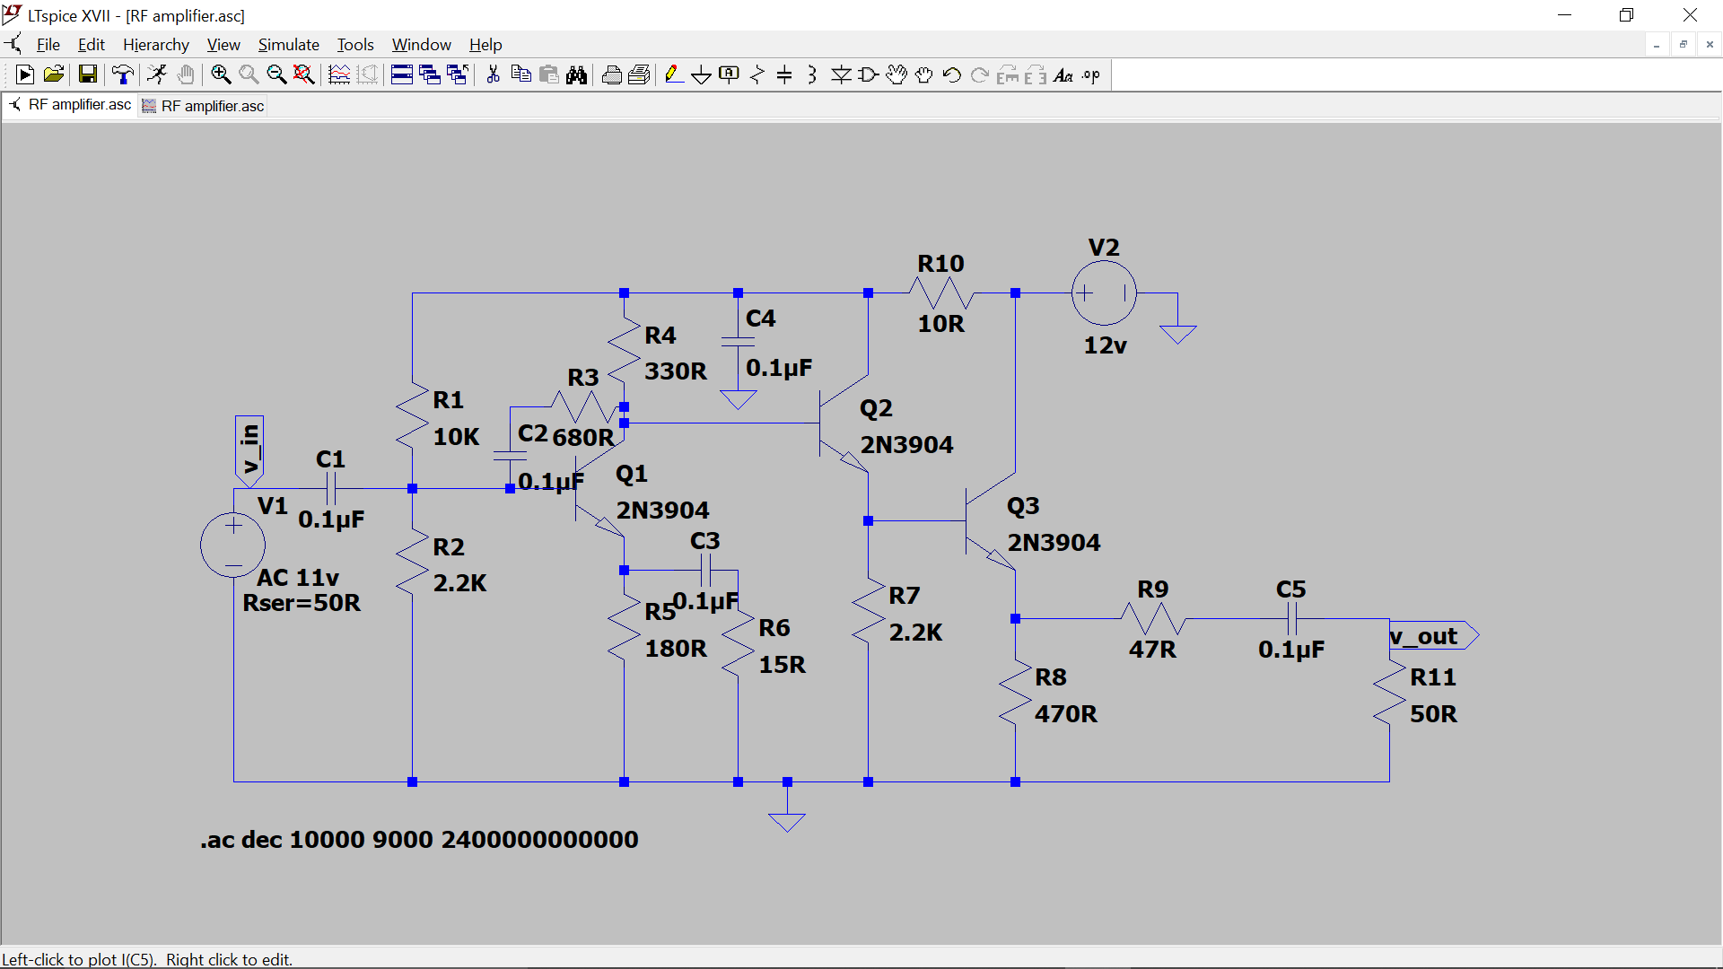
Design

Slide 4
The amplifier above is supposed to have a gain of around 15-20dB
We were able to successfully simulate the circuit and the results were as shown.

Slide 5
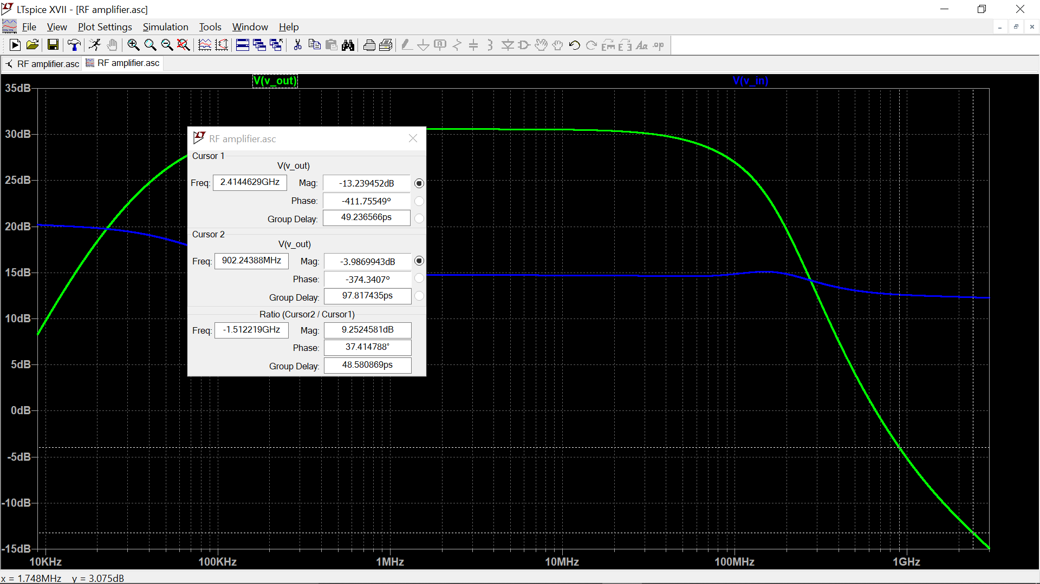
Simulation results

Slide 6
Our desired frequencies of operation are 900MHz and 2.4GHz.
It is clear that these frequencies are outside the gain-band of the amplifier above as shown above. The output power at these frequencies is lower than the input power showing that the signal is actually losing power at these frequencies.
The results are precise as this is a radio frequency power amplifier and our frequencies e.g 2.4GHz falls in the microwave frequency band.

Slide 7
Conclusion
This amplifier is no good for the frequencies we want to operate in.
We need to design a power amplifier for higher frequencies.

